Slide 1

Google Sites

Slide 2

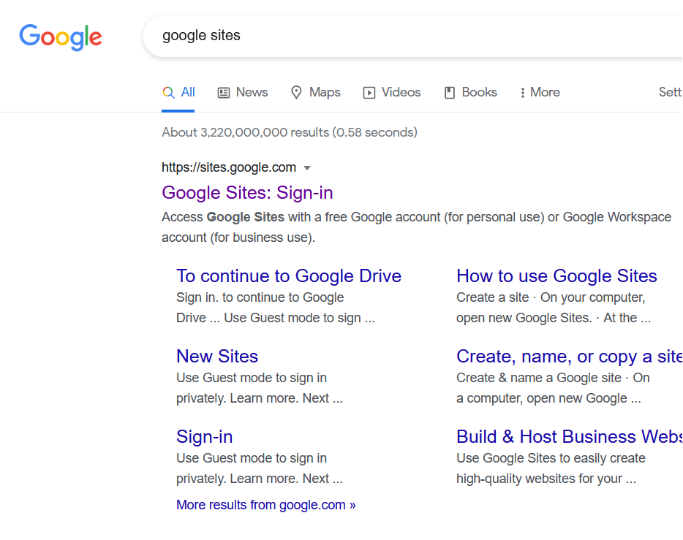
Create and account
Or just use existing google account.

Slide 3
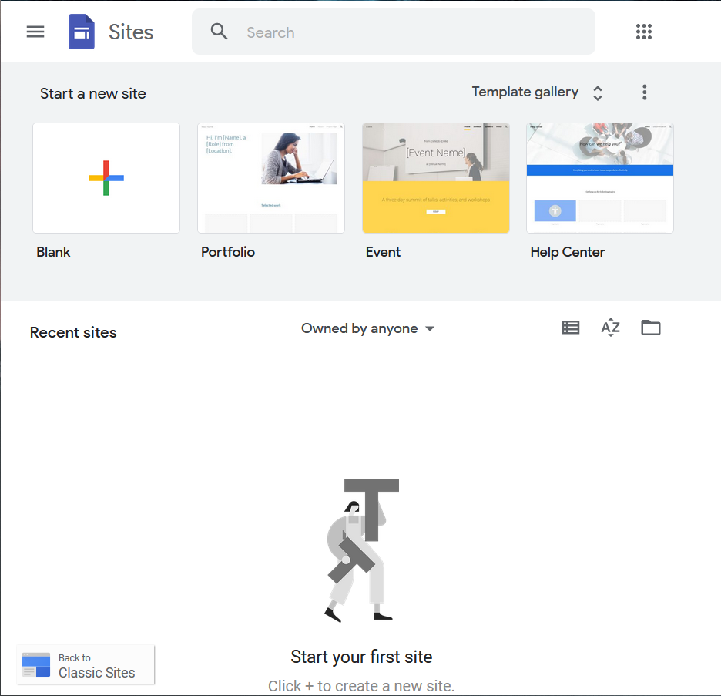
Landing page
Click on “NEW”

Slide 4
Some good online resources to learn about google sites
https://support.google.com/sites/answer/6372878?hl=en
https://sites.google.com/site/tiesitestutorial/home
https://sites.google.com/view/how-to-with-new-sites/home

Slide 5
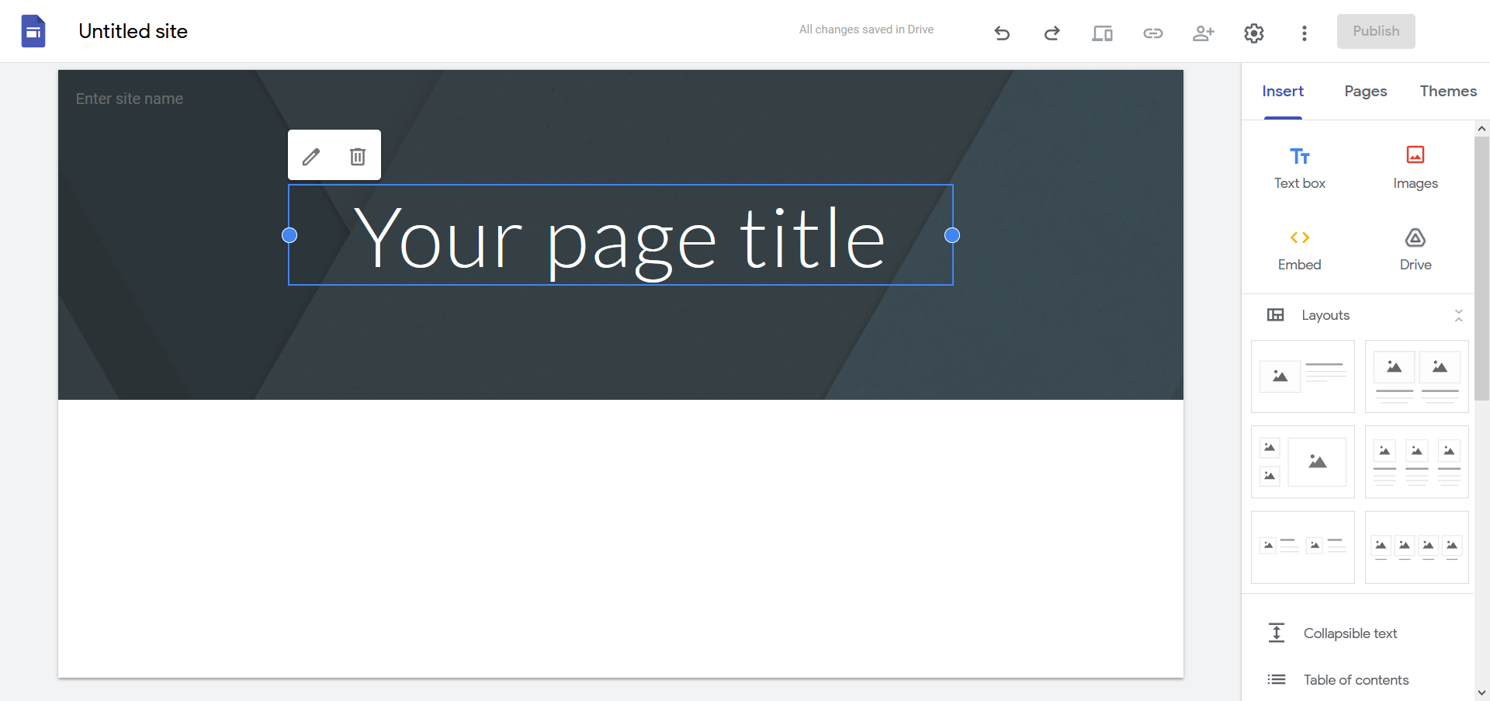
How to navigate Google Site?
Notes:
Most of the stuffs can be found here

Slide 6

Adding in components
Double-click and select:
Image
Text
Embed
Upload from gDrive

Slide 7
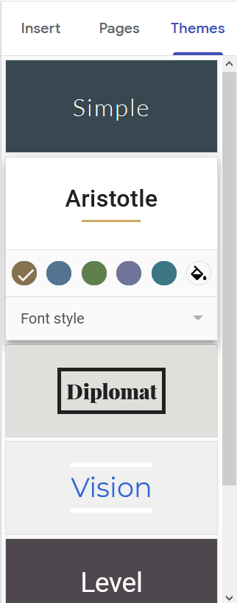
You may select themes

Slide 8
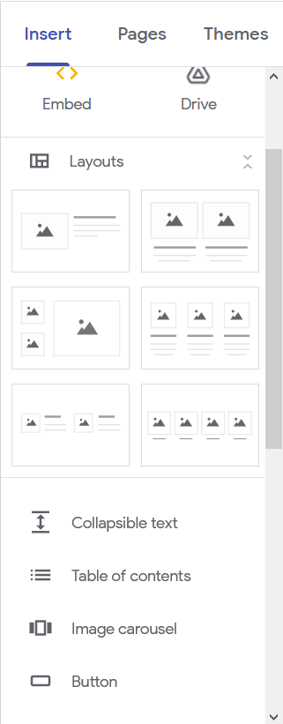
Choose pre-defined layouts

Slide 9
Linking existing knowledge to new territories
Examples:
Table of Contents ←→ <nav>
Image carousel ←→ polaroid
Button ←→ <button>

Slide 10
Cool features
Adding of google documents into website e.g., google doc, google slides, etc.
Embedding YouTube videos on website.

Slide 11
Other website builders
Wordpress
Wix
Weebly
Squarespace
Etc.
Notes:
I chose to introduce Google Sites due to its simplicity

Slide 12
Feedback form
https://docs.google.com/forms/d/e/1FAIpQLSdGv8iNrYukdFT7YNNouOEpjAO_j4z1oAoYlIgBRMp6iLg6Tg/viewform?usp=pp_url
PLEASEEEEE answer truthfully and give me your honest feedback so I know what are my strengths and weaknesses.
Thank you!

Slide 13
Summary
HTML
CSS
Own website!
Learnt how to create website using vanilla HTML + CSS and touched on website builders such as Google Sites.

